Slide 1
Ecommerce shopping
Let's start our presentation

Slide 2
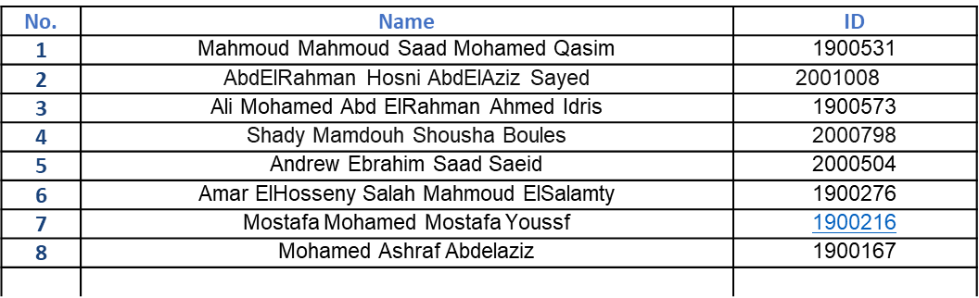
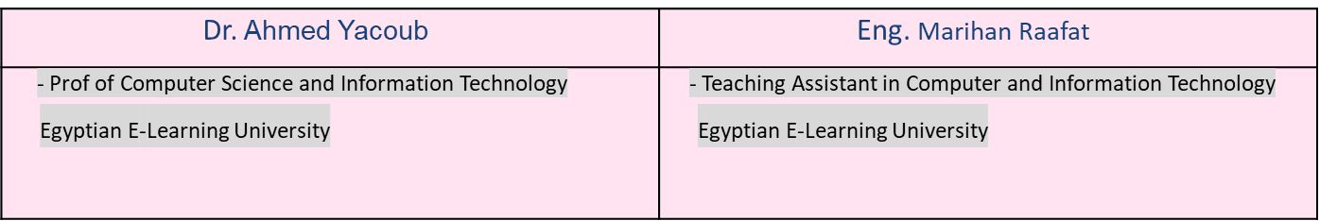
Title: A machine learning –based recommender system for E-Commerce Your Name: names Date: [25/6/2024] Under Supervision of:

Slide 3
Project Overview
This project involves the creation of a fully functional online store designed to sell various products, utilizing modern web development technologies including PHP, jQuery, HTML, CSS, and JavaScript. The online store provides a seamless user experience, allowing customers to browse products, add items to their cart, and complete purchases efficiently . To enhance the shopping experience, the project integrates a recommendation system. This system leverages user data and behavior to suggest products that are likely to be of interest to the customer, thereby increasing user engagement and sales.

Slide 4
Purpose
01
02
we have a keen interest in the rapidly growing field of e-commerce. Developing an online store allowed me to explore and understand the intricate details of how modern online retail platforms are built and operated . Skill Enhancement This project provided an opportunity to apply and enhance my skills in various web development technologies such as PHP, jQuery, HTML, CSS, and JavaScript. Working on this project allowed me to gain hands-on experience and improve my proficiency in these areas . Real-World Application
Building an online store with a recommendation system has real-world relevance and practicality. It demonstrates how technology can be used to solve real business problems, making the project not just an academic exercise but a practical solution that can be implemented in the marketplace.

Slide 5
Is this project important ?
Consumer Convenience :
E-commerce platforms provide immense convenience to consumers by allowing them to shop from the comfort of their homes. This project emphasizes the importance of creating user-friendly interfaces and efficient back-end systems to facilitate seamless online shopping experiences.
Business Growth:
For businesses, having an online presence is crucial in today's digital age. An effective online store can reach a wider audience, operate 24/7, and significantly boost sales. This project showcases how businesses can leverage technology to expand their reach and grow.

Slide 6
Is this project important ?
Personalized Shopping Experience :
The recommendation system is a key feature that highlights the importance of personalized shopping experiences. By suggesting products based on user behavior and preferences, it enhances customer satisfaction and encourages repeat purchases.
Technological Integration :
The project demonstrates the integration of various technologies to create a cohesive system. It shows how front-end and back-end technologies can be harmoniously combined to build a functional and robust online platform.

Slide 7
Languages and Tools Used
PHP, jQuery, HTML, CSS, JavaScript
php | PHP is used as the primary server-side scripting language for this project. It handles the business logic of the online store, such as processing user requests, interacting with the database, and managing sessions.
Database Interaction | PHP provides robust functionality to connect with databases, making it easier to perform CRUD operations. For this project, PHP is used to interact with a MySQL database to manage product information, user data, and order details.
jQuery | jQuery makes it easy to handle events such as clicks, hovers, and form submissions. This allows for the creation of interactive features like product image carousels and AJAX-powered search functionality.
HTML | HTML (HyperText Markup Language) is the backbone of the web pages, providing the essential structure and layout of the online store. Each page, including the home page, product listings, and checkout page, is built using HTML.
JavaScript | JavaScript adds interactivity to the web pages, enhancing the user experience. It is used for functionalities like form validation, dynamic content updates, and interactive elements such as modals and dropdown menus.
CSS and Responsive Design | Using CSS media queries, the project ensures that the online store is responsive and looks good on various devices, from desktops to smartphones. This adaptability is crucial for providing a good user experience across different screen sizes.

Slide 8
Reason for Choice These Technologies
PHP
Wide Adoption and Community Support:
PHP is widely used in web development and has a large community, providing a wealth of resources, libraries, and frameworks. This makes it easier to find solutions to common problems and to get support.
Server-Side Scripting Efficiency:
PHP is highly efficient for server-side scripting, allowing for dynamic content generation and seamless interaction with databases. It's particularly well-suited for building e-commerce platforms where server-side operations are crucial.
Ease of Integration:
PHP easily integrates with various databases (especially MySQL), HTML, and frontend technologies, making it a versatile choice for web development.
jQuery:
Simplified JavaScript:
jQuery simplifies many of the tasks that would require complex JavaScript code, such as DOM manipulation, event handling, and AJAX calls. This results in faster development and cleaner code.
Cross-Browser Compatibility:
jQuery handles cross-browser issues, ensuring that the web application works consistently across different web browsers without needing to write multiple sets of code.
Rich Plugin Ecosystem:
There is a vast ecosystem of jQuery plugins available for adding various functionalities to a website, saving development time and effort.

Slide 9
Reason for Choice These Technologies
HTML:
Fundamental Web Language:
HTML is the standard markup language for creating web pages. It provides the basic structure of a webpage, making it essential for any web development project.
Compatibility and Accessibility:
HTML is universally supported by all browsers, ensuring that the content is accessible to all users. Its semantic elements improve SEO and make the content more accessible to screen readers.
CSS:
Styling and Design:
CSS is crucial for defining the look and feel of a website. It separates content from presentation, allowing for more flexibility in design and easier maintenance.
Responsive Design:
CSS enables responsive design, ensuring that the website looks good on all devices, from desktops to mobile phones. This is essential for modern web development where users access websites on various screen sizes.
Advanced Layouts:
Modern CSS features like Flexbox and Grid make it easier to create complex, responsive layouts, enhancing the overall user experience.

Slide 10
What Issue or Need Does Your Online Store Address?

Slide 11
Here are five important ideas
Convenience of Online Shopping :
Wide Product Selection:
Personalized Shopping Experience:
Consumers increasingly prefer the convenience of shopping online over visiting physical stores. An online store allows customers to browse and purchase products from the comfort of their homes, at any time of day.
Traditional brick-and-mortar stores have limited shelf space, restricting the variety of products they can offer. An online store can showcase a vast inventory without space constraints, providing customers with a broader selection of products.
Shoppers today expect personalized experiences that cater to their preferences and needs. Physical stores often struggle to offer such personalization due to a lack of data-driven insights into customer behavior.

Slide 12
Here are five important ideas
Scalability and Reach:
Cost Efficiency:
Small and medium-sized businesses (SMBs) face challenges in scaling their operations and reaching a broader audience. An online store can scale more easily and reach customers globally without significant additional costs.
Operating a physical store involves high costs, including rent, utilities, and staffing. An online store reduces these overheads, allowing businesses to allocate resources more effectively and potentially offer more competitive pricing.

Slide 13
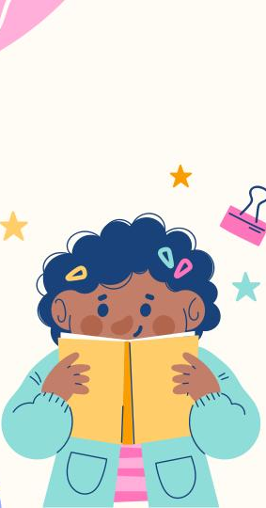
1. Understanding Recommendation Systems:
Recommendation systems are algorithms designed to suggest items (movies, products, music, etc.) to users based on their preferences, behavior, and historical data.
In the context of movie recommendations, systems typically utilize collaborative filtering, content-based filtering, or hybrid approaches.
Collaborative filtering identifies similarities between users or items based on user ratings or interactions, recommending items that similar users have liked.
Content-based filtering recommends items similar to those a user has previously liked, based on the attributes or features of the items.

Slide 14
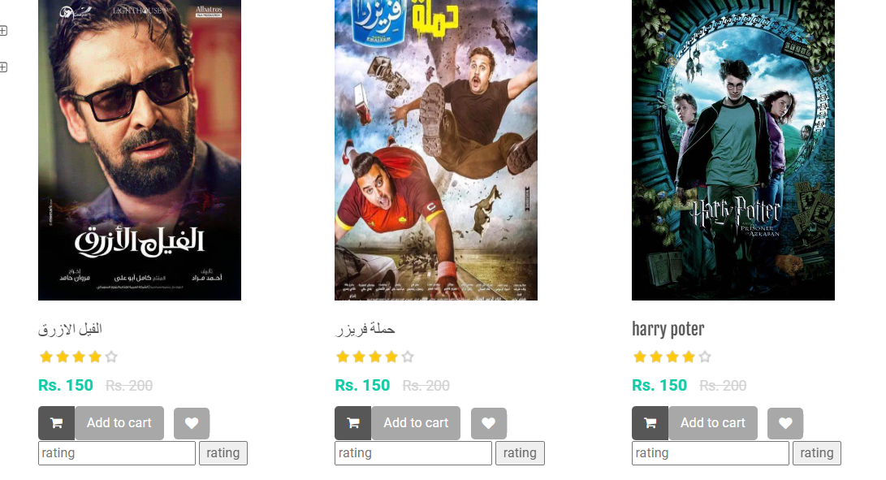
How the recommendation system works
My site's recommendation system works by having users rate movies based on their preferences and then displaying these ratings to other users to help them choose movies that contain other users' ratings.

Slide 15
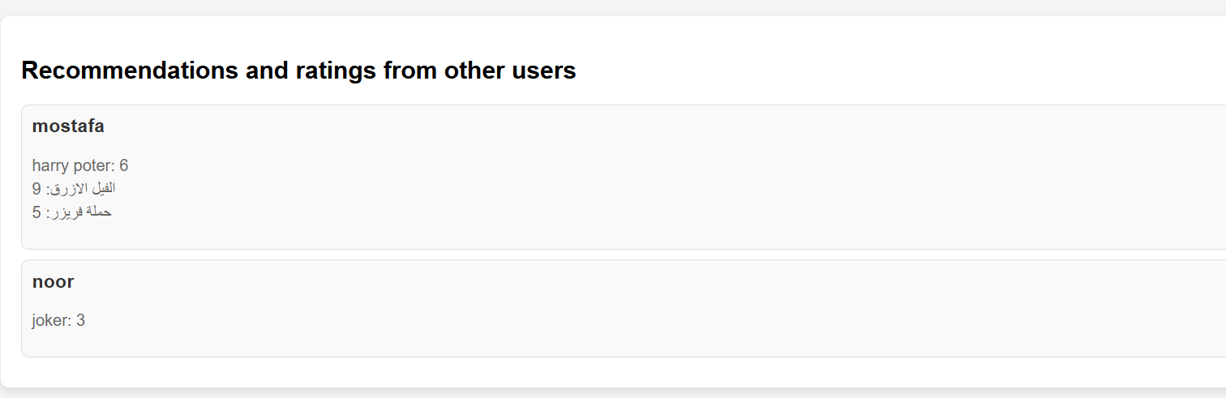

How the recommendation system works
You click on the show recommandtion button to see the recommendations of other users and their recommendations to you, and from these results you can choose the best movies suitable for you based on the recommendations of other users, so the recommendation system helps you reach

Slide 16
Introduction to Payment Gateway:
Secure payment processing is critical for any e-commerce website, so we used a payment gateway from Stripe in the website, a platform that processes online payments and protects user data
Integrating Stripe: Adding the Secret Key to Your Site
Introduction. Today, we'll go through the steps to obtain your Stripe secret key and add it to your website.
Step 1: Create a Stripe Account
Go to Stripe's website.
Sign up for an account if you don't already have one.
Verify your email address and complete the account setup.
Step 2: Access the Stripe Dashboard
Log in to your Stripe account.
Navigate to the dashboard where you can manage your Stripe settings.
Step 3: Navigate to API Keys
In the dashboard, find the "Developers" section.
Click on "API keys" to view your keys.

Slide 17
Stripe payment gateway :
Step 4: Copy the Secret Key Details:Under "API Keys," locate the "Secret Key."Click to reveal the key and copy it.Note: Keep this key secure; it should be treated like a password.
Step 5: Add the Secret Key to Your CodeDetails:Depending on your backend technology, add the secret key to your server-side code.

Slide 18
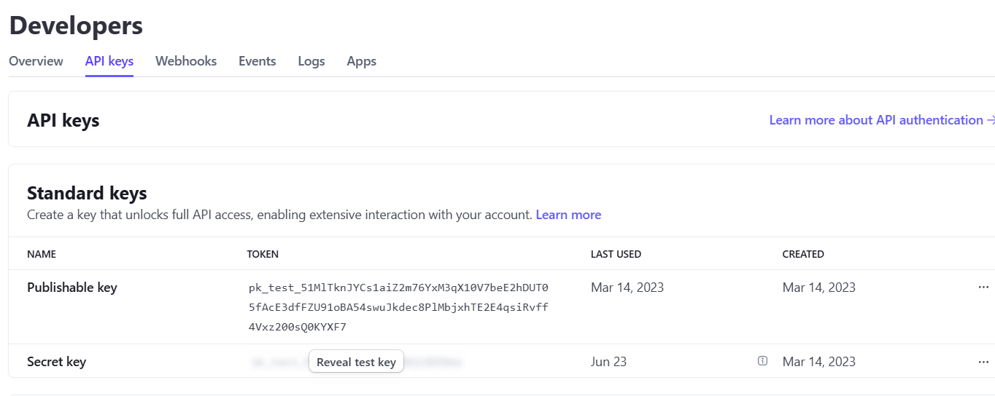
How Stripe Payment Gateway Works ?
We extract the secret key from the stripe website and put this payment gateway API in my website so that all payments are processed through the stripe payment gateway to facilitate the payment process for the user of my website and protect his credit card to make this data more secure and to preserve the user's data.

Slide 19
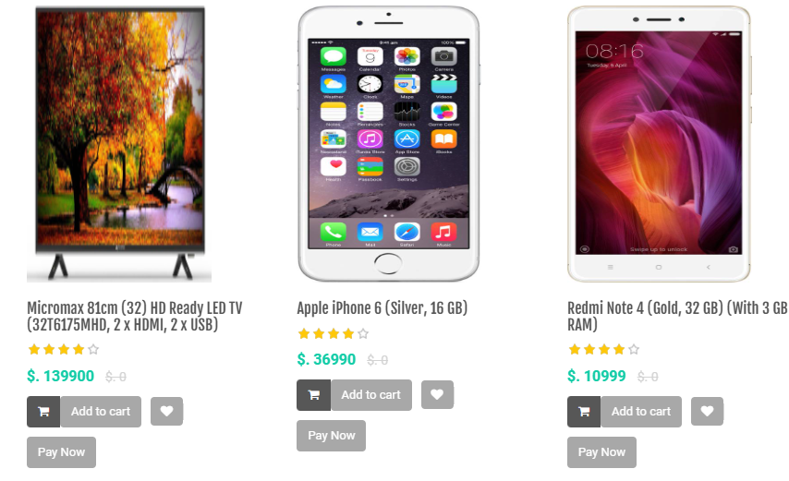
How Stripe Payment Gateway Works ?
When selecting any product in any category and we want to purchase this product, we click on the pay now button to complete the purchase process and then proceed to the next stage

Slide 20
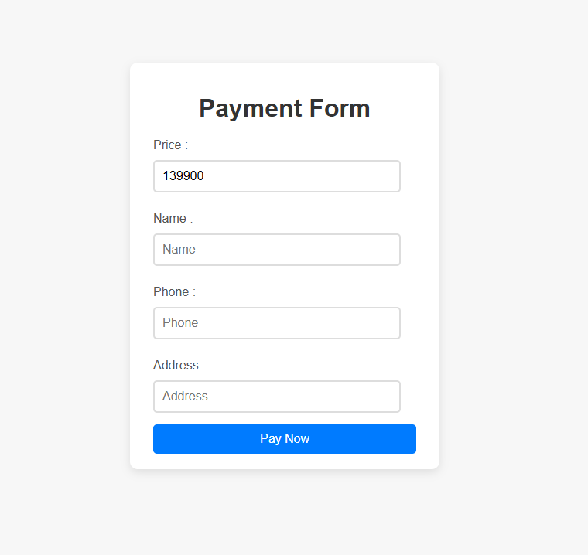
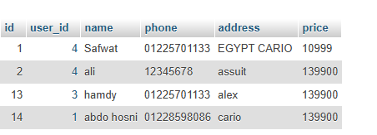
How Stripe Payment Gateway Works ?
At this stage, we ask the user to enter his personal data to use this data to know some information about the user who purchased the product so that we can deliver the product to him, so we save this data in the database so that we can reach this customer

Slide 21
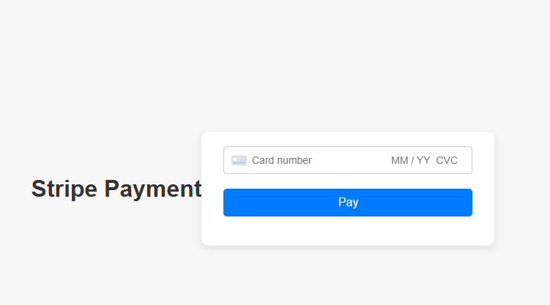
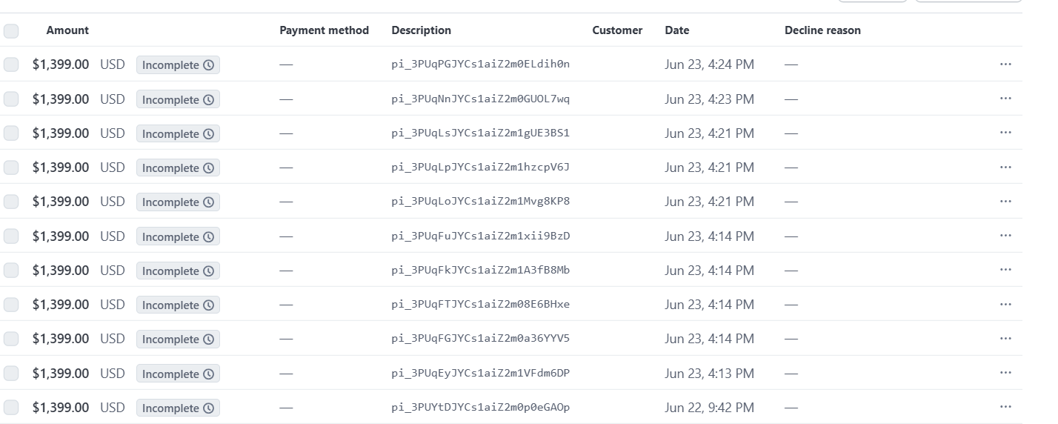
Stripe API for Payment Processing
The Stripe API is a powerful and versatile tool designed to handle online payment processing. It is widely used by businesses of all sizes to accept payments, manage subscriptions, handle payouts, and more. Stripe provides a unified platform for managing payments and financial operations, making it a preferred choice for developers and businesses alike.
Key Features of Stripe API
1. Payment Processing
Card Payments: Stripe supports major credit and debit cards from customers globally. It handles all aspects of payment processing, including authorization, capture, and refunds.
Alternative Payment Methods: Stripe supports a variety of payment methods such as Apple Pay, Google Pay, ACH transfers, SEPA Direct Debit, and more, making it flexible for customers worldwide.
2.Security
ensuring that payment data is handled securely.

Slide 22
Live Demonstration for E-Commerce Project

Slide 23
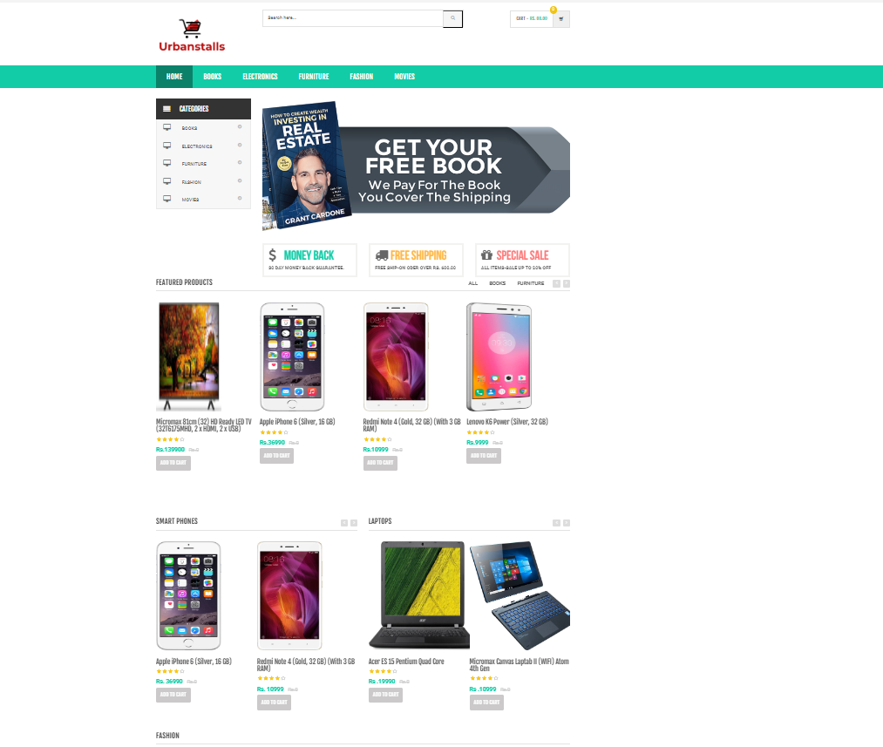
Home Page

Slide 24
Home Page Details
login
category
To register users on my site for the need of some information in the purchasing process and opinions
All categories to make it easy for the user to navigate the category they want
products
cart
All products appear in all sections to display these products for sale
It is a shopping cart for the user to buy the products they want from our website

Slide 25
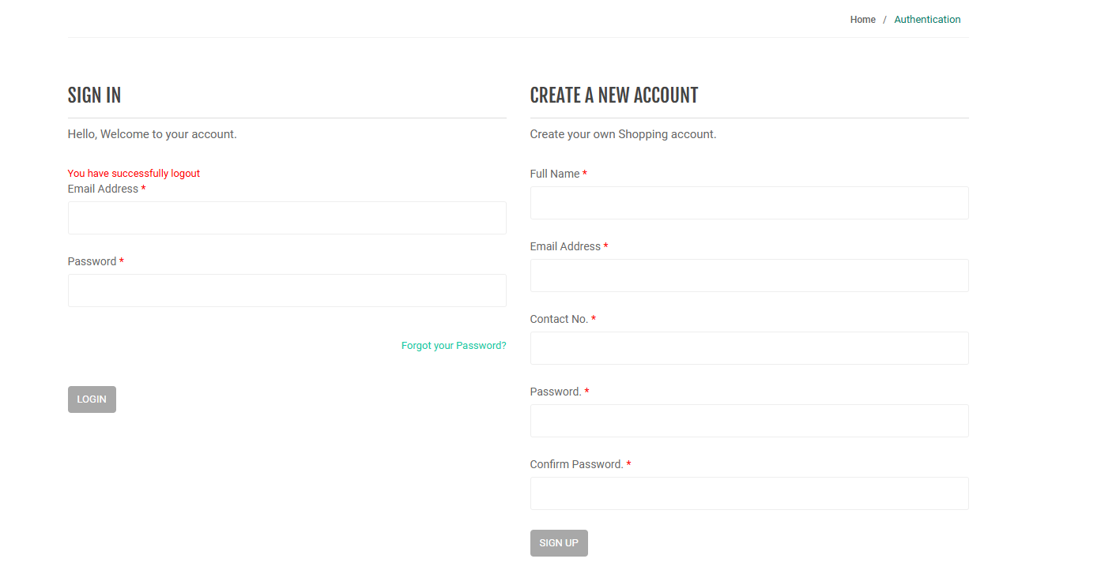
login

Slide 26
Highlight the main navigation menu, including links to different product categories

Slide 27
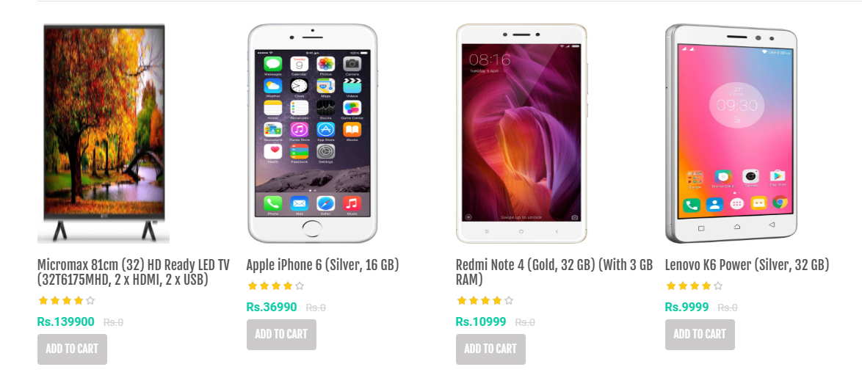

3. Shopping Cart and Checkout
You can add any product by clicking on the add to cart button , Add a product to the cart and proceed to the checkout process.

Slide 28
Admin Dashboard

Slide 29
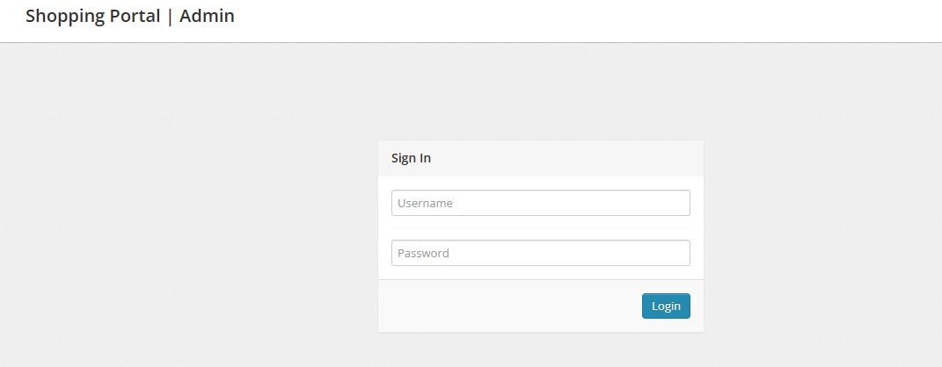
Login to admin dashboard
This page is for admins to edit, add products, and modify all things on the website, but with the conditions of access through the login page

Slide 30
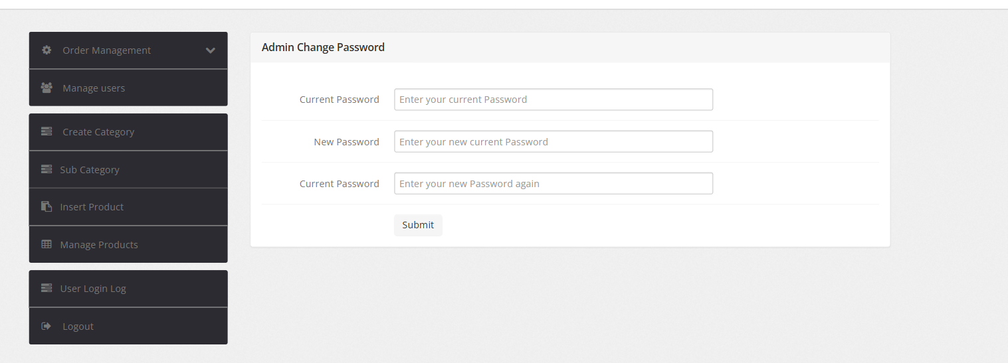
Admin dashboard
This page is for admins to edit, add products, and modify all things on the website, but with the conditions of access through the login page

Slide 31
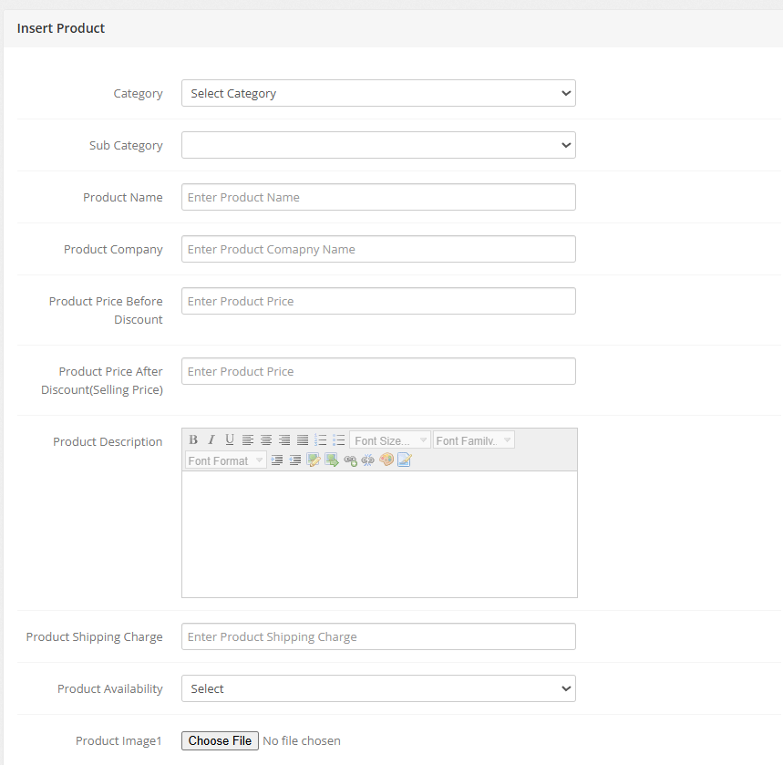
Insert products
For example, this page allows the administrator to add the products that will appear on my site by specifying the category in which the product will appear and uploading an image of this product, so the administrator can easily add his products

Slide 32
Thanks!

